Slide 1
Unleashing JonMon: Deep Insights into Your Windows Activity By: Jonny Johnson

Slide 2

Jonny Johnson (@jsecurity101)
Sr. Security Researcher of Adversarial Techniques and Capabilities @BinaryDefense
Interests
Windows Internals
Extracting and Exposing Telemetry
Working on my Tacoma
Brazilian Jiu Jitsu
Open-Source Author/Contributor
The Defender’s Guide
TelemetrySource
Atomic Test Harnesses
Formerly
Sr. Threat Research @RedCanary
Sr. Consultant @SpecterOps

Slide 3
The Problem
Collection assumptions
Interacting with telemetry mechanisms
Understanding various event sources
Attributes exposed through events
“If we are honest with ourselves, we have to admit that sometimes our assumptions and preconceived notions are wrong, and therefore, our interpretation of events is incorrect. This causes us to overreact, to take things personally, or to judge people unfairly.” – Elizabeth Thornton

Slide 4
Let’s take a trip to the past…

Slide 5
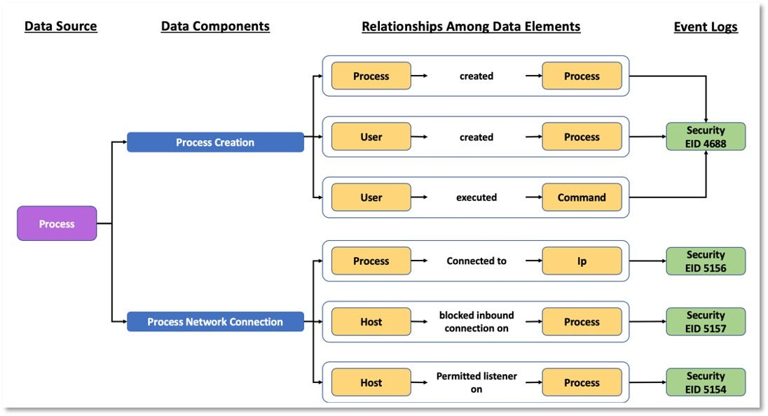
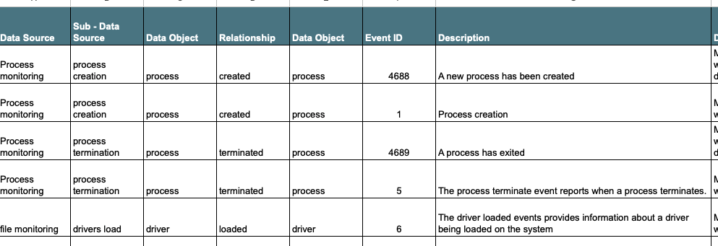
Event Mapping (data source to events)
In 2018 the Rodriguez brothers created mappings to help defenders understand object to action relationships
@Cyb3rWard0g
@Cyb3rPandaH
https://medium.com/threat-hunters-forge/mapping-att-ck-data-sources-to-security-events-via-ossem-%EF%B8%8F-b606d99e738c

Slide 6
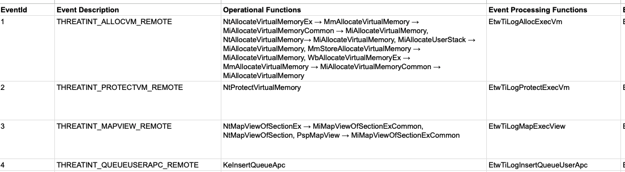
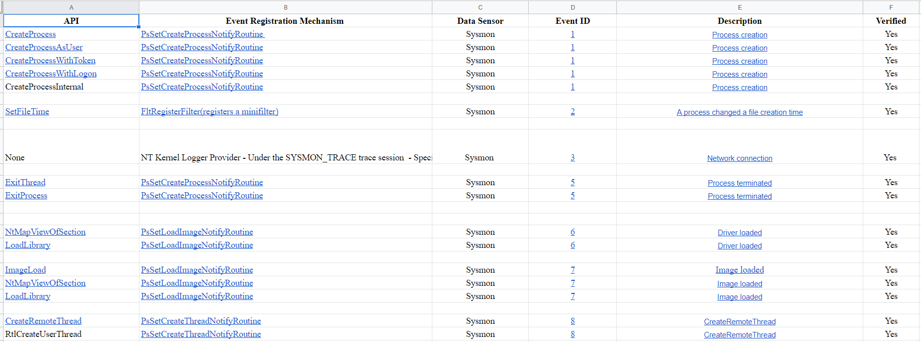
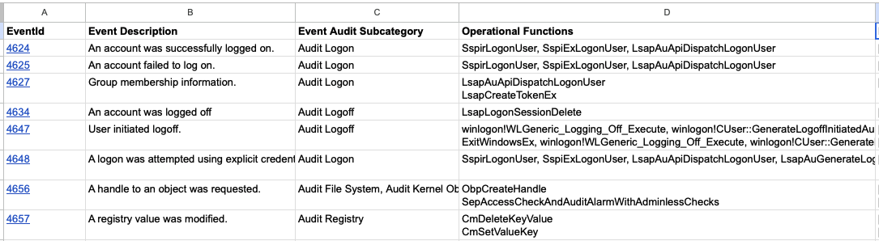
Event Mapping (mechanism to event)
TelemetrySource, previously API-to-EventId, was started in 2019 to build on previous research to understand how vendors were logging actions

Slide 7
Insert JonMon
Formerly known as Accio
(Thank you Olaf for the rename)

Slide 8
Purpose
Allows researchers to test telemetry ideas
Code base for defenders to understand telemetry technologies
NOT meant for production environments – I am not a developer
Push telemetry forward with ALL vendors
Build better detection ideas based on telemetry
Telemetry collection performance

Slide 9
Disclaimers
Still in beta
Pending performance feedback from the community
Not meant to run in production environments
Meant to be used as a research tool, not a full-time telemetry sensor

Slide 10
Internals
Kernel Driver (JonMon.sys)
Win32 Service (JonMon-Service.exe) - Runs as PPL
Manifest ETW Provider (JonMon.man)
User-Mode Exentions (JonMon-Ext1.dll)

Slide 11
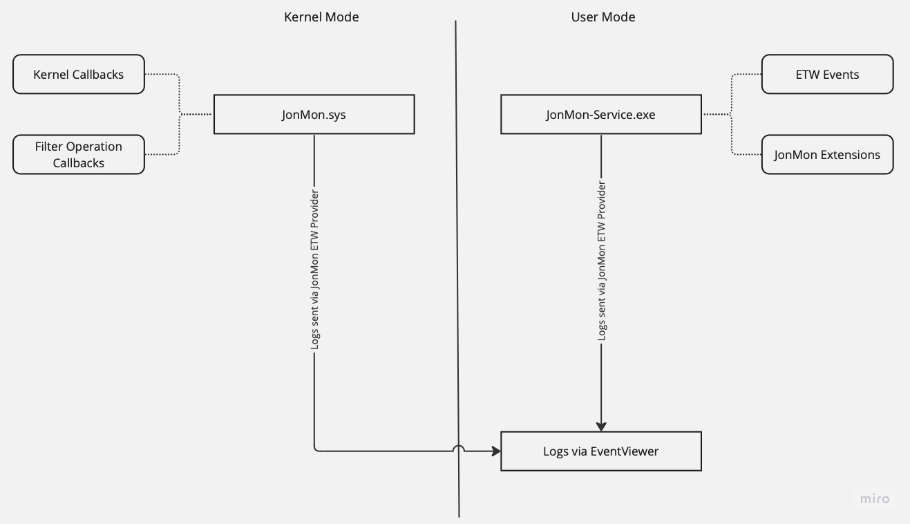
Internals cont.d

Slide 12
Kernel Callbacks
EventID | EventType | Collection Mechanism
1, 8 | Process Creation & Process Reparenting | PsSetCreateProcessNotifyRoutineEx
2 | OpenProcess | ObRegisterCallback (Post-Callback)
3 | DuplicateHandle | ObRegisterCallback (Post-Callback)
5, 6, 7, 14 | Registry Events | RegistryCallback
4, 27 | ImageLoad & DriverLoad | PsSetLoadImageNotifyRoutine
18 | Create Remote Thread | PsSetCreateThreadNotifyRoutine

Slide 13
Event Tracing for Windows (ETW)
EventID | EventType | Collection Mechanism
30 | Memory Read | Threat-Intelligence
29 | Memory Write | Threat-Intelligence
13 | Network (TCP) | Microsoft-Windows-Kernel-Network
15 | DotNet Load | Microsoft-Windows-DotNETRuntime
11, 12 | RPC Calls | Microsoft-Windows-RPC
28 | DPAPI | Microsoft-Windows-Crypto-DPAPI
32 | Remote Virtual Allocation | Threat-Intelligence

Slide 14
User-Mode Extensions
EventID | EventType | Collection Mechanism
31 | Thread Token Impersonation | Process & Thread Query

Slide 15
Installation
Requires TESTSIGNING to be ON
Suggest DEBUG to be ON
Easier for debugging
Easier to help with issues

Slide 16
Demos

Slide 17
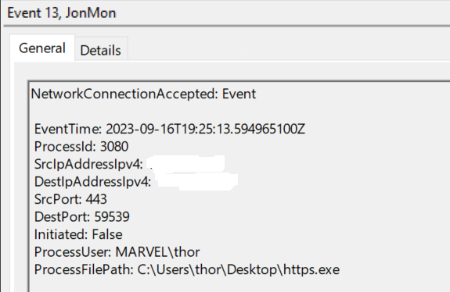
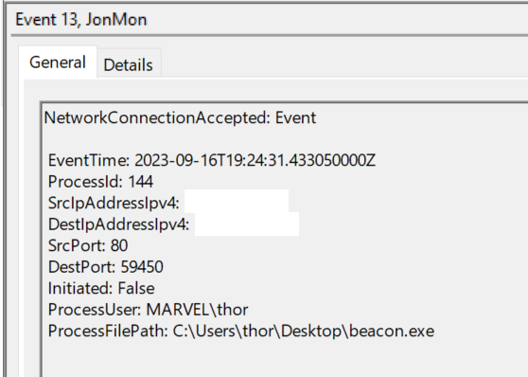
Cobalt Strike Beacon (TCP/IP)
Event ID 13 – TCP Connections

Slide 18
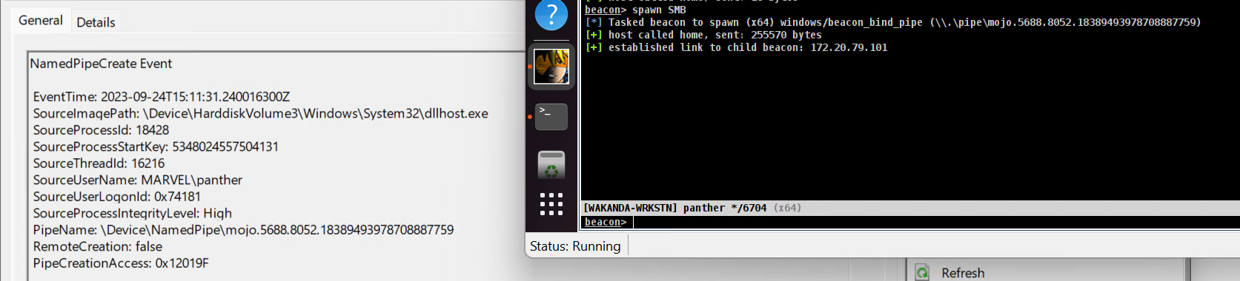
Cobalt Strike Beacon (Named Pipe)
Event ID 23 – Named Pipe Creation

Slide 19
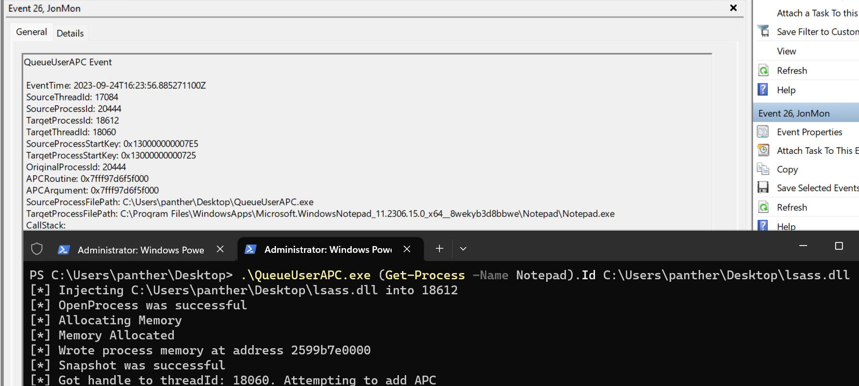
QueueUserAPC
Event ID 26 - QueueUserAPC

Slide 20
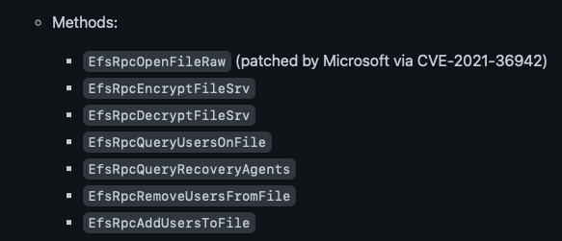
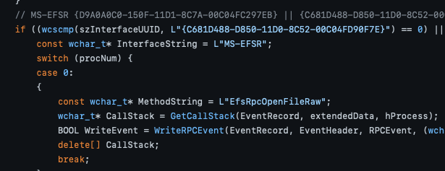
RPC Calls
Don’t need to collect “everything”
Focus on collecting known bad

Slide 21
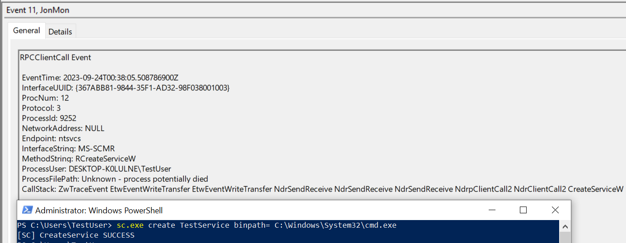
RPC Calls
Event ID 11 - Client

Slide 22
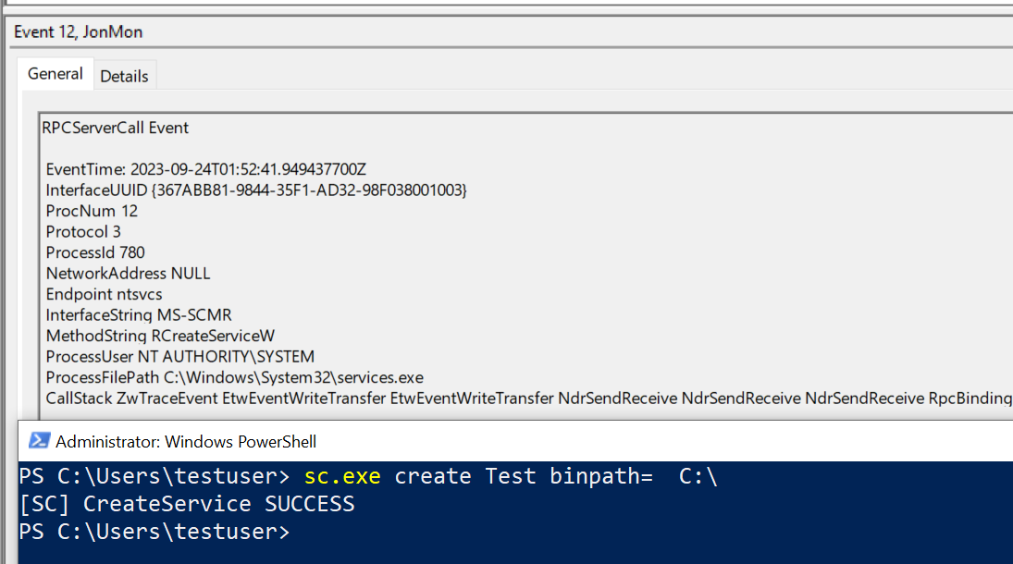
RPC Calls
Event ID 12 - Server

Slide 23
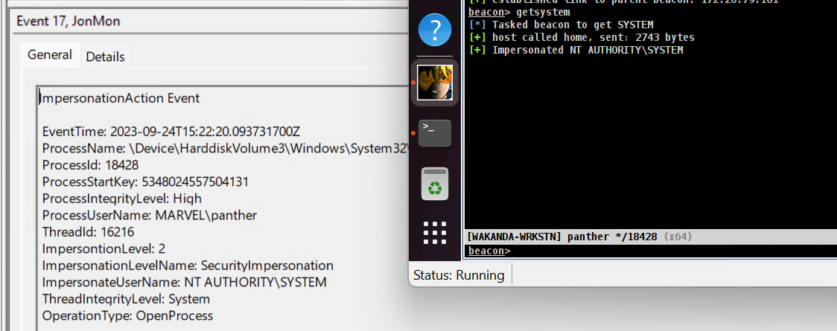
Token Impersonation
Event ID 17 - PsReferenceImpersonationToken

Slide 24
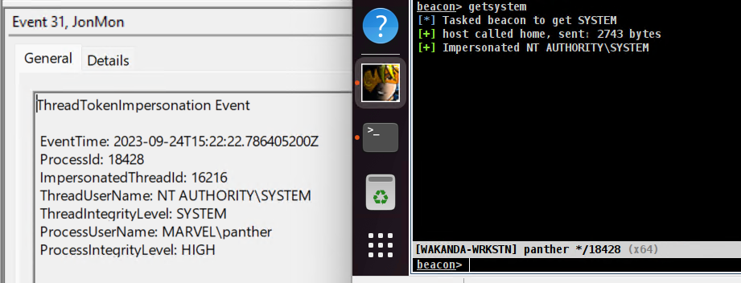
Token Impersonation
Event ID 31 – Thread Token Impersonation

Slide 25
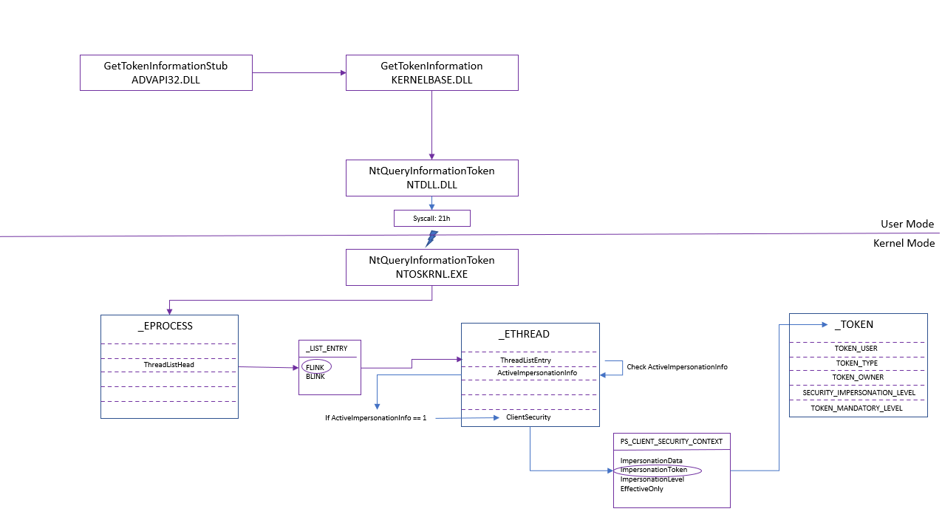
Token Impersonation
https://medium.com/@jsecurity101/better-know-a-data-source-access-tokens-and-why-theyre-hard-to-get-7bc951eae0b9

Slide 26

WMI Event Subscription
Event ID 25 – WMIFilterToConsumerBinding

Slide 27
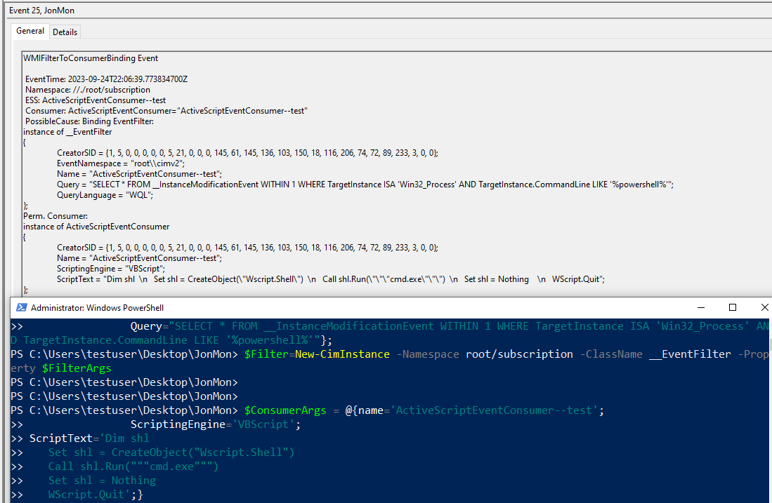

Slide 28
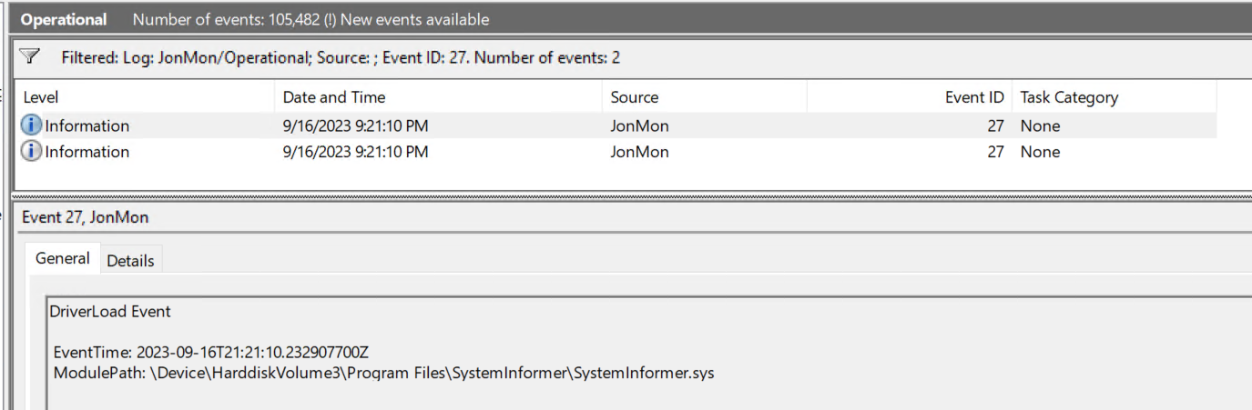
Drivers Loads
Event ID 27– Driver Load

Slide 29
Lessons Learned
Kernel development isn’t for the faint of heart
Make the kernel do as little work/processing as possible
Telemetry isn’t necessarily easy to obtain
Event consistency
Understanding telemetry mechanisms helps improve Windows Internals knowledge
Metadata isn’t just “given”

Slide 30
ROADMAP
Config file
Move from Manifest ETW to Tracelogging
OSSEM
1
3
5
2
4
6
Collaboration
Templates
Minifilter multi-threading
..AND MORE!!!

Slide 31
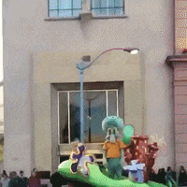
Bad News…..
Code isn’t quite ready yet..
SIKE!!!!!!!!!!
GO TO:
https://github.com/jsecurity101/JonMon

Slide 32

Thanks! Go have fun

